Slide 1

Introduction briefing
India, population & illness
Health care in India – public vs private
TB in India
The leaky ‘cascade of care’
Private provider engagement demonstrations – quick overview
Demonstration results & impact
ICT as part of the solution

Slide 2
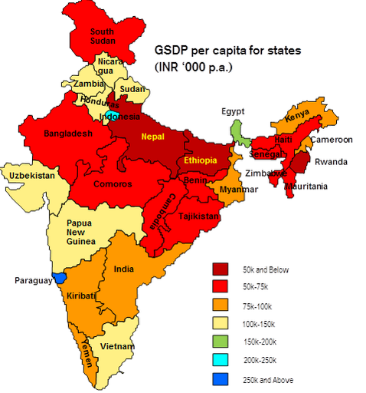
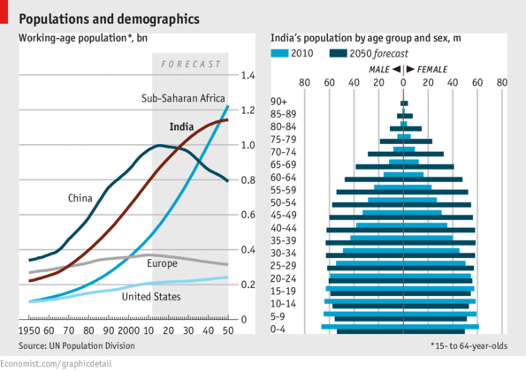
India, population & wealth

Slide 3
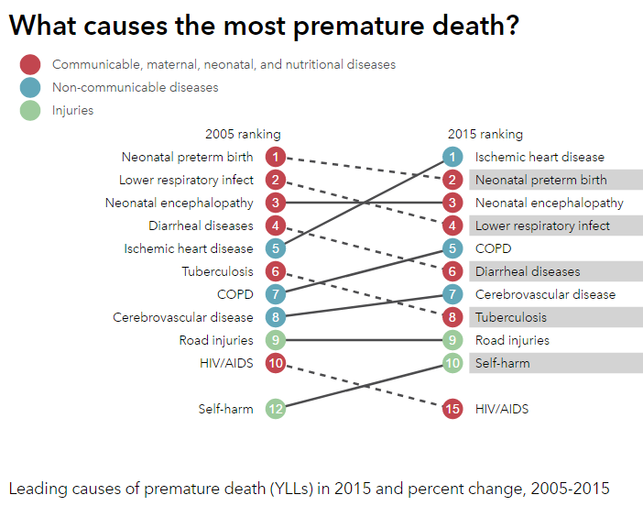
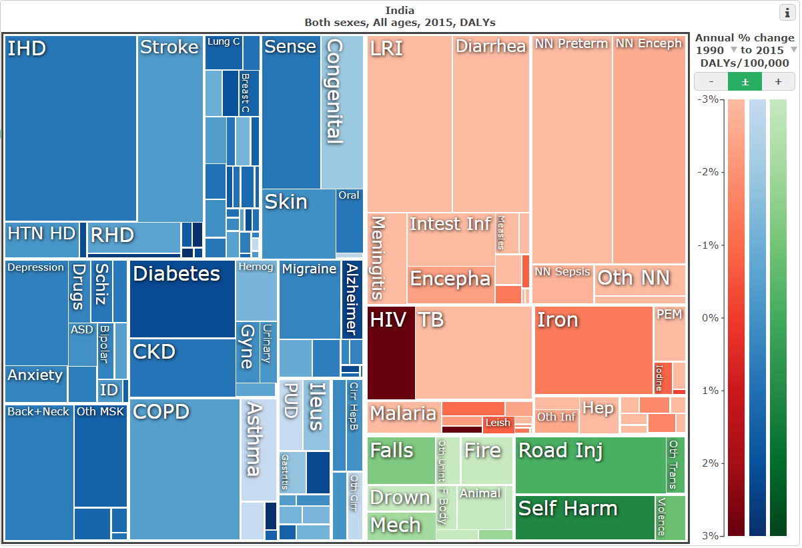
What kills Indians?
3.5% of all DALYs lost
6% among men
IHME, 2016

Slide 4
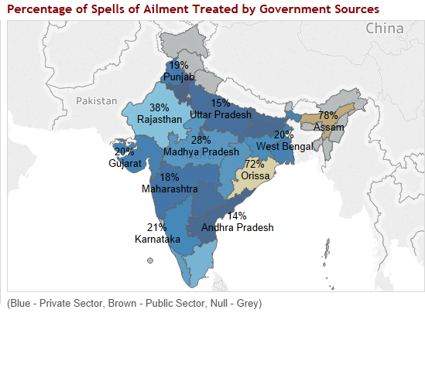
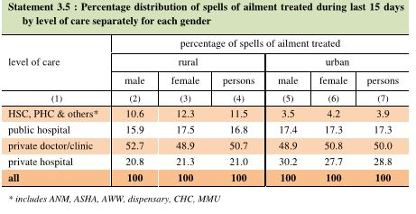
Indians mostly seek care from private providers
National Sample Survey, Jan-June 2014
As shown repeatedly, most recently by the 2014 National Sample survey, ~70% of health care sought has been from private providers. This strong trend holds across rural or Urban, North or South states, and among rich or poor Indians.
Exceptions: Childbirth (70% public), immunizations (80% public), and tertiary care seeking for surgery/hospitalization (50% public)

Slide 5
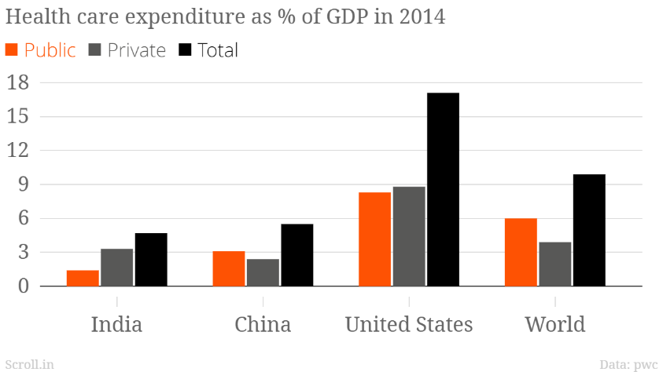
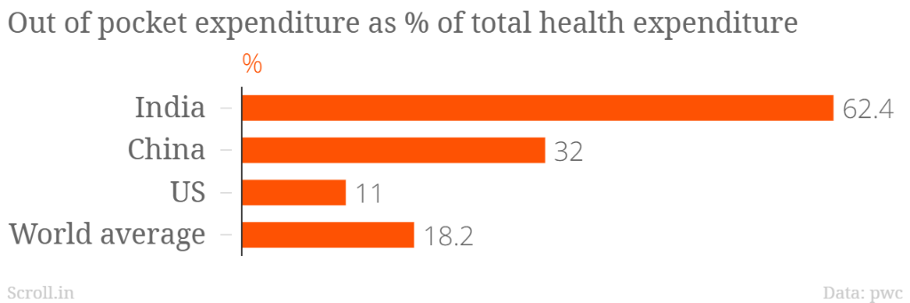
Most health care spending – Private & OOP

Slide 6
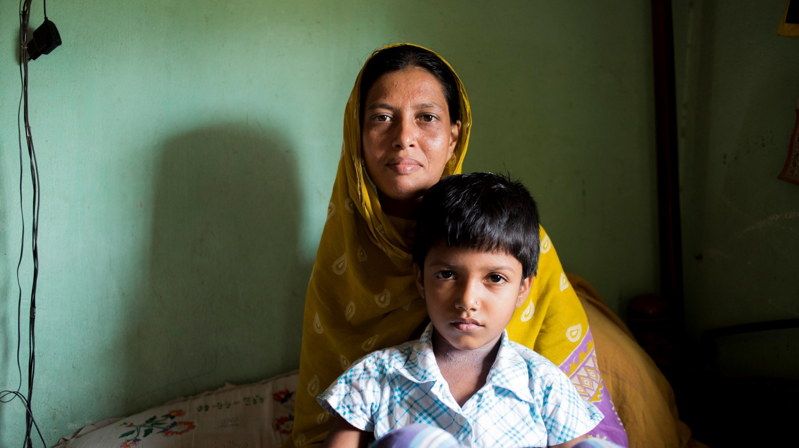
TB in India
Mrs Nurjahan and her daughter, Nargis
Photo courtesy Lilly MDR TB partnership

Slide 7
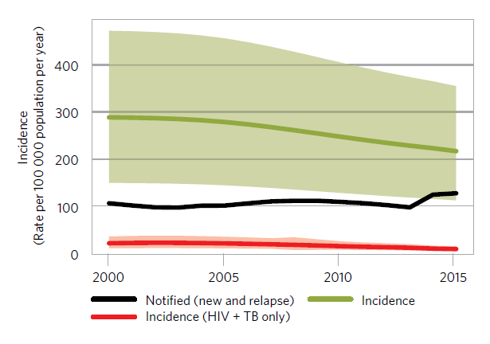
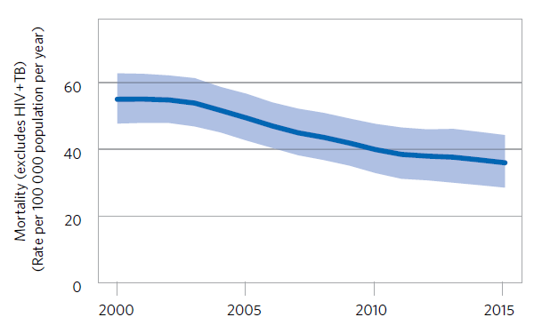
TB in India
WHO estimates revised for 2015 from new prevalence survey & mortality data
Incidence, 2015
217/100,000 (Uncertainty interval 112–355)
2.8m (1.4–4.6m) cases; 1.67m [60%] cases notified
Mortality
36/100,000 (29-45)
0.48m (0.38-0.59m) TB deaths annually
Low overall MDR, with hotspots (2016 national DRS)
2.8% among new, 12% among re-treatment cases
Low HIV prevalence among TB, with hotspots
67% TB routinely HIV tested, ~5% of tested are HIV+
Source: WHO Global TB Report 2016

Slide 8
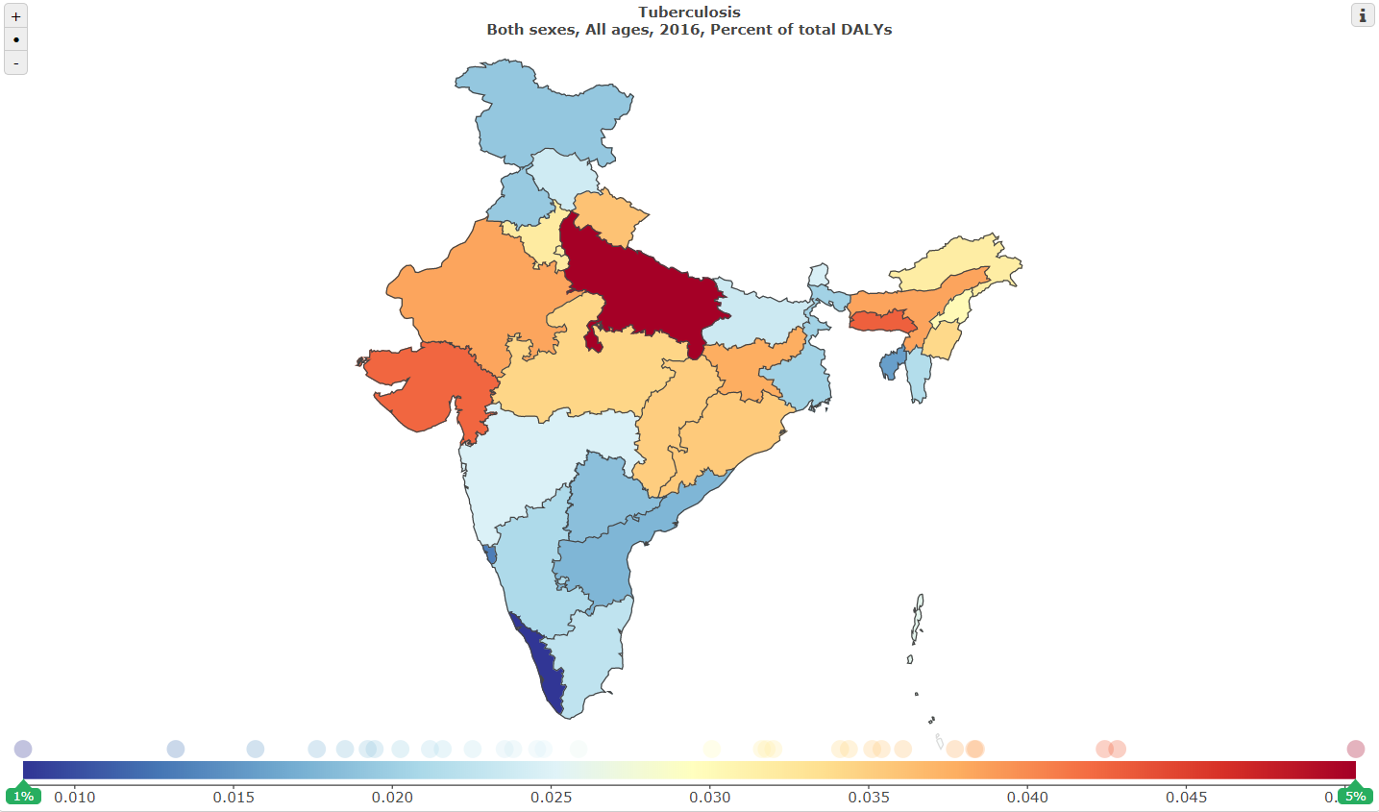
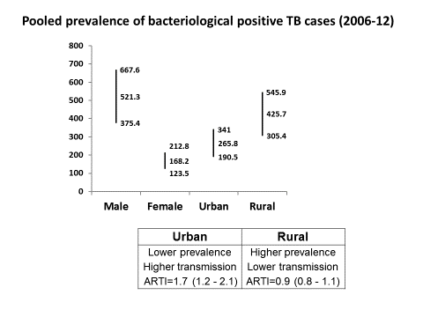
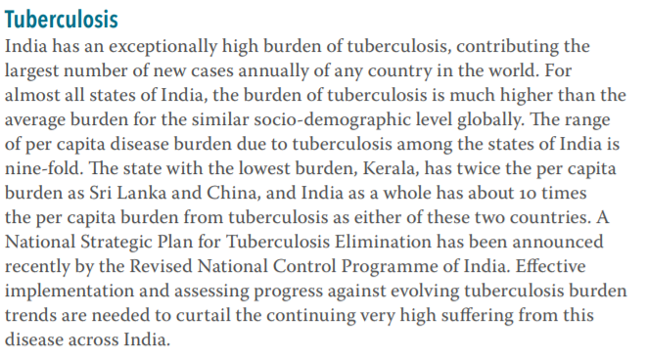
TB in India
UP: 10x TB DALY rate than Kerala
20x TB DALY rate of China
→2.8 m incident cases
→480,000 annual deaths
ICMR & IHME, Health of the Nation’s States, 2017
Courtesy: National TB Institute, Bangalore

Slide 9
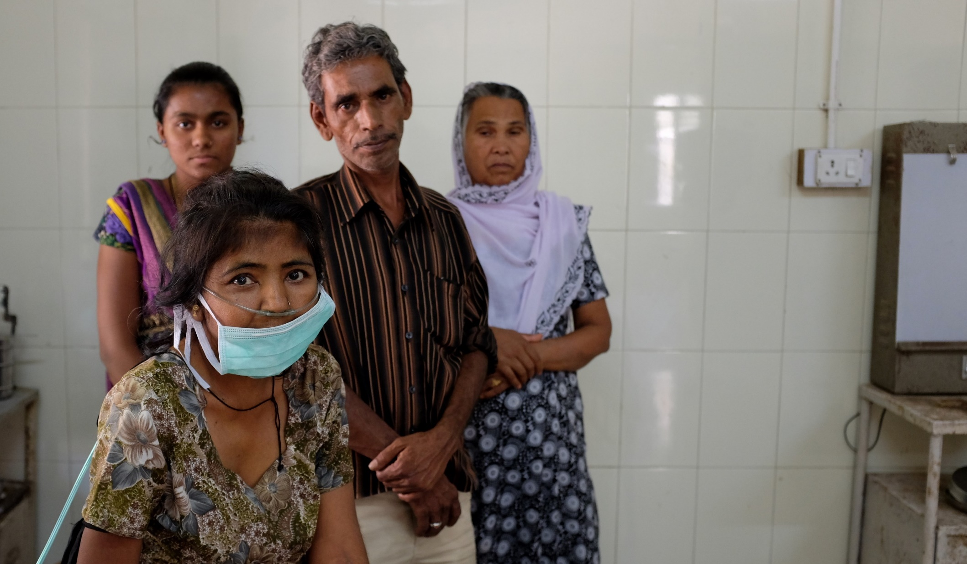
the ugly math…
1 in 460 Indians (280-890) get TB every year→
480,000 TB deaths/year
1,315 deaths/day
54 deaths/hour
1 TB death every
1 minute 6 seconds
Name withheld on request, MDR-TB patient from Kucch, with her younger sister & parents
Photo P Dewan, 2015

Slide 10
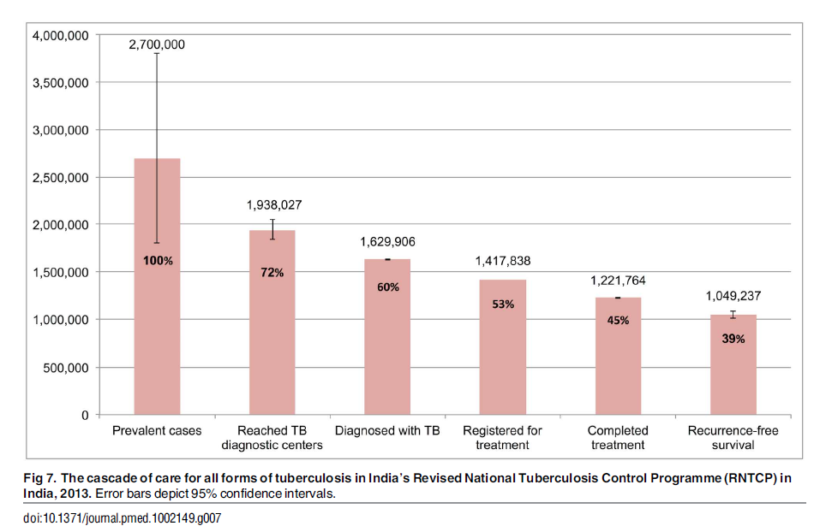
The leaky cascade of TB care, India 2013
Private care, or
undiagnosed/untreated
Public care, including
~46% end-to-end loss
Source: Subbaraman R, et al, PlosMed Oct 2016

Slide 11
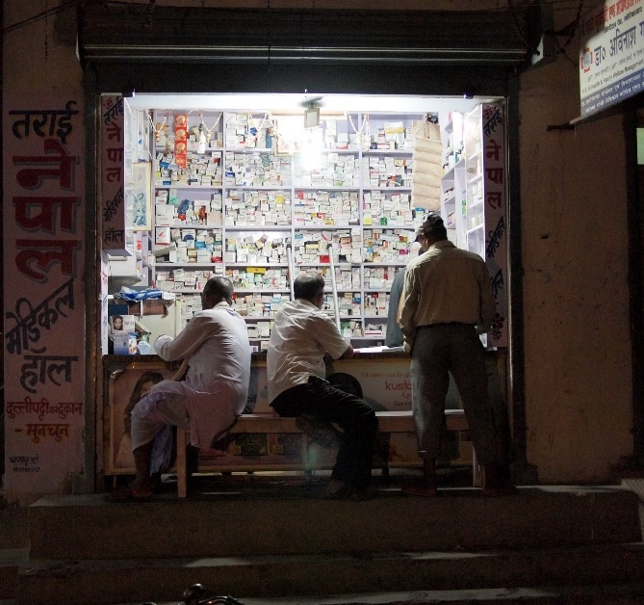
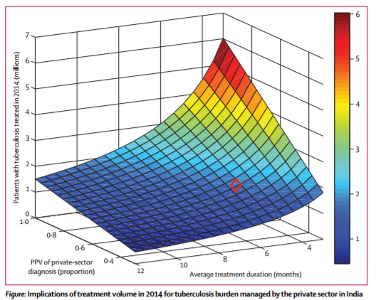
Large quantum of Privately-sold anti-TB drugs
…implies substantial, but uncertain, privately-treated TB caseload.
Arinaminpathy et al, Lancet ID 2016

Slide 12
Integrated Cascade of Care, by sector Care-seeking
1. Initial General Care Seeking Patterns
2. Access to Diagnosis In Initial Care Seeking
3. Estimated Cases
4. TB Treatment Location
5. Treatment Outcome
Level of Initial Care Seeking
% of Health Facilities with Microscopy/GX Capacity Available
% of Patients Accessing Facility with Microscopy
35% Informal Private Care*^
Estimated “Missing” Cases
(54%) – Assumed to be private sector
Died
Chronic
Self Cure
~60% Private Sector
40% Poor Outcome
L2
5% Dx in Formal Private
39% Formal Private Care*
13%
Patients may iterate through the diagnosis pathway multiple time before being initiated on treatment.
15%
20% Tx Success
L1
26%
Extra-Pul.
7%
10%
Clinical Dx
12%
~40% Public Sector
5% Poor
35%
Tx Success
26% Public Care
17%
L2
70% Public Care
Bact. Confirmed
24%
93%
21% Dx in Public Care
9%
L1
56%
Source: Global cascade of care analysis, Linksbridge & McGill 2016, Work in Progress
*The split of private sector between formal/informal is reflective of available data from studies in Patna and Mumbai, thus representing the urban split. In rural areas, this split likely includes a greater share of informal providers; ^Assume that informal private care don’t have diagnostic capacity, and patients shift for formal or public providers subsequently

Slide 13
Care Cascade in Private Sector
Cannot be described with confidence, as data are sparse
However, using ongoing studies and programmatic data, the following observations are possible
TB diagnostic delays are common in the private sector (~60 days) and about 3 providers are seen before TB is diagnosed (Mistry N et al, PLoS ONE 2016; FMR Reports on Pathways to Care in Mumbai and Patna; Sreeramareddy et al. IJTLD 2014)
Patients endure a long pathway with multiple visits and several missed opportunities for diagnosis (Mistry N et al, PLoS ONE 2016; Engel N et al. BMC Health Serv 2015; Das J et al. Lancet ID 2016)
Simulated patient surveys show that majority (~80) of patients with presumed TB do NOT get microbiological testing (Das J et al. Lancet ID 2015; QuTUB ongoing studies)
Empirical management of suspected TB is widespread (McDowell & Pai, IJTLD 2016; McDowell & Pai, Trans Roy Soc Trop Med 2016)
Even when tests are ordered, it is usually chest x-rays (not sputum TB tests)
Quality of TB care in suboptimal (Satyanarayana S et al. IJTLD 2015; Das J et al. Lancet ID 2015)
Treatment success rate unknown, but among patients in PPIA project was about 40% with free drugs, and is now about 70 – 85% ‘best case scenario’ (PATH and WHP PPIA data)

Slide 14
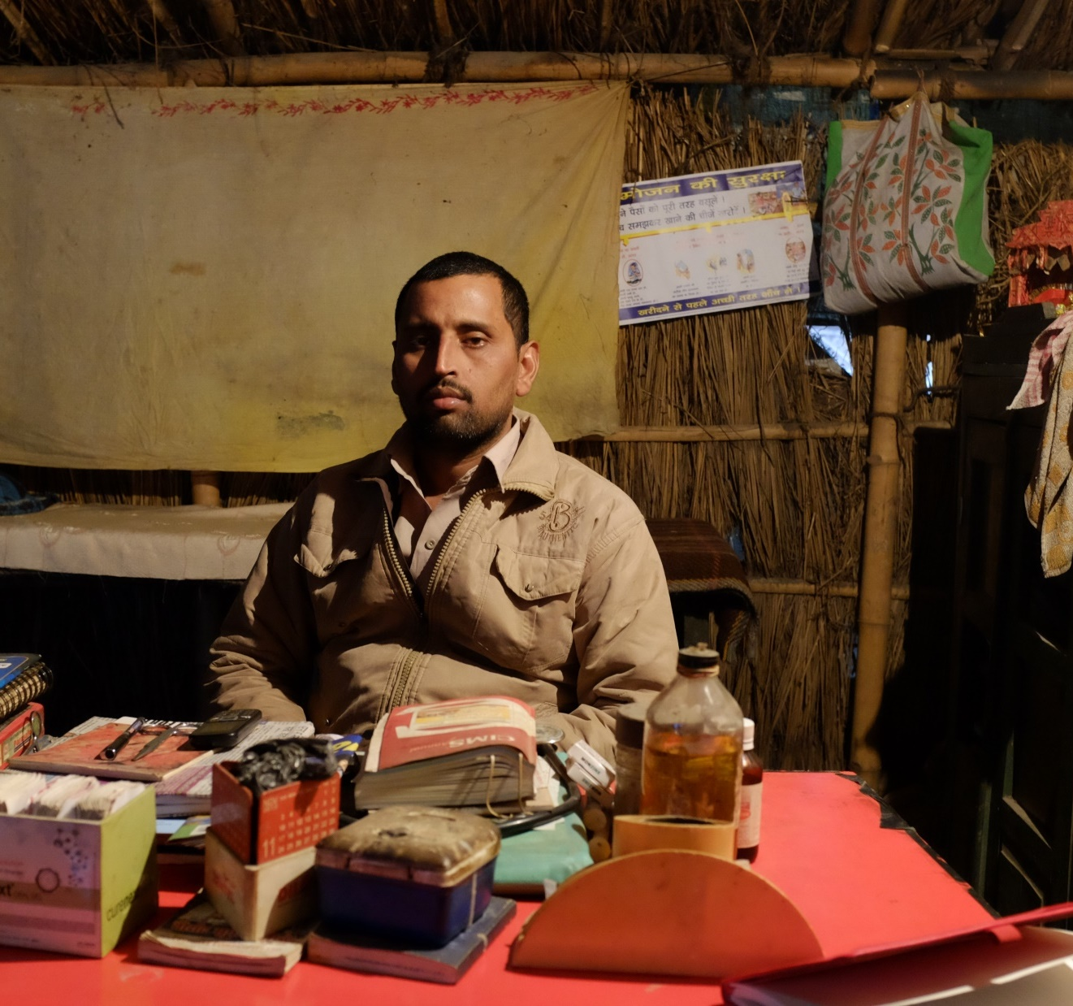
Cascade of care Implications
Huge up front losses..
Mainly to private sector
Private sector dominance is a function of basic health seeking behaviors of the population
Without patient tracking, private treatment not accountable
Public: Small stepwise leakages yield substantial cumulative loss.
Large opportunities to capture cases and improve treatment
→Private engagement
→Fixing public cascade leaks

Slide 15
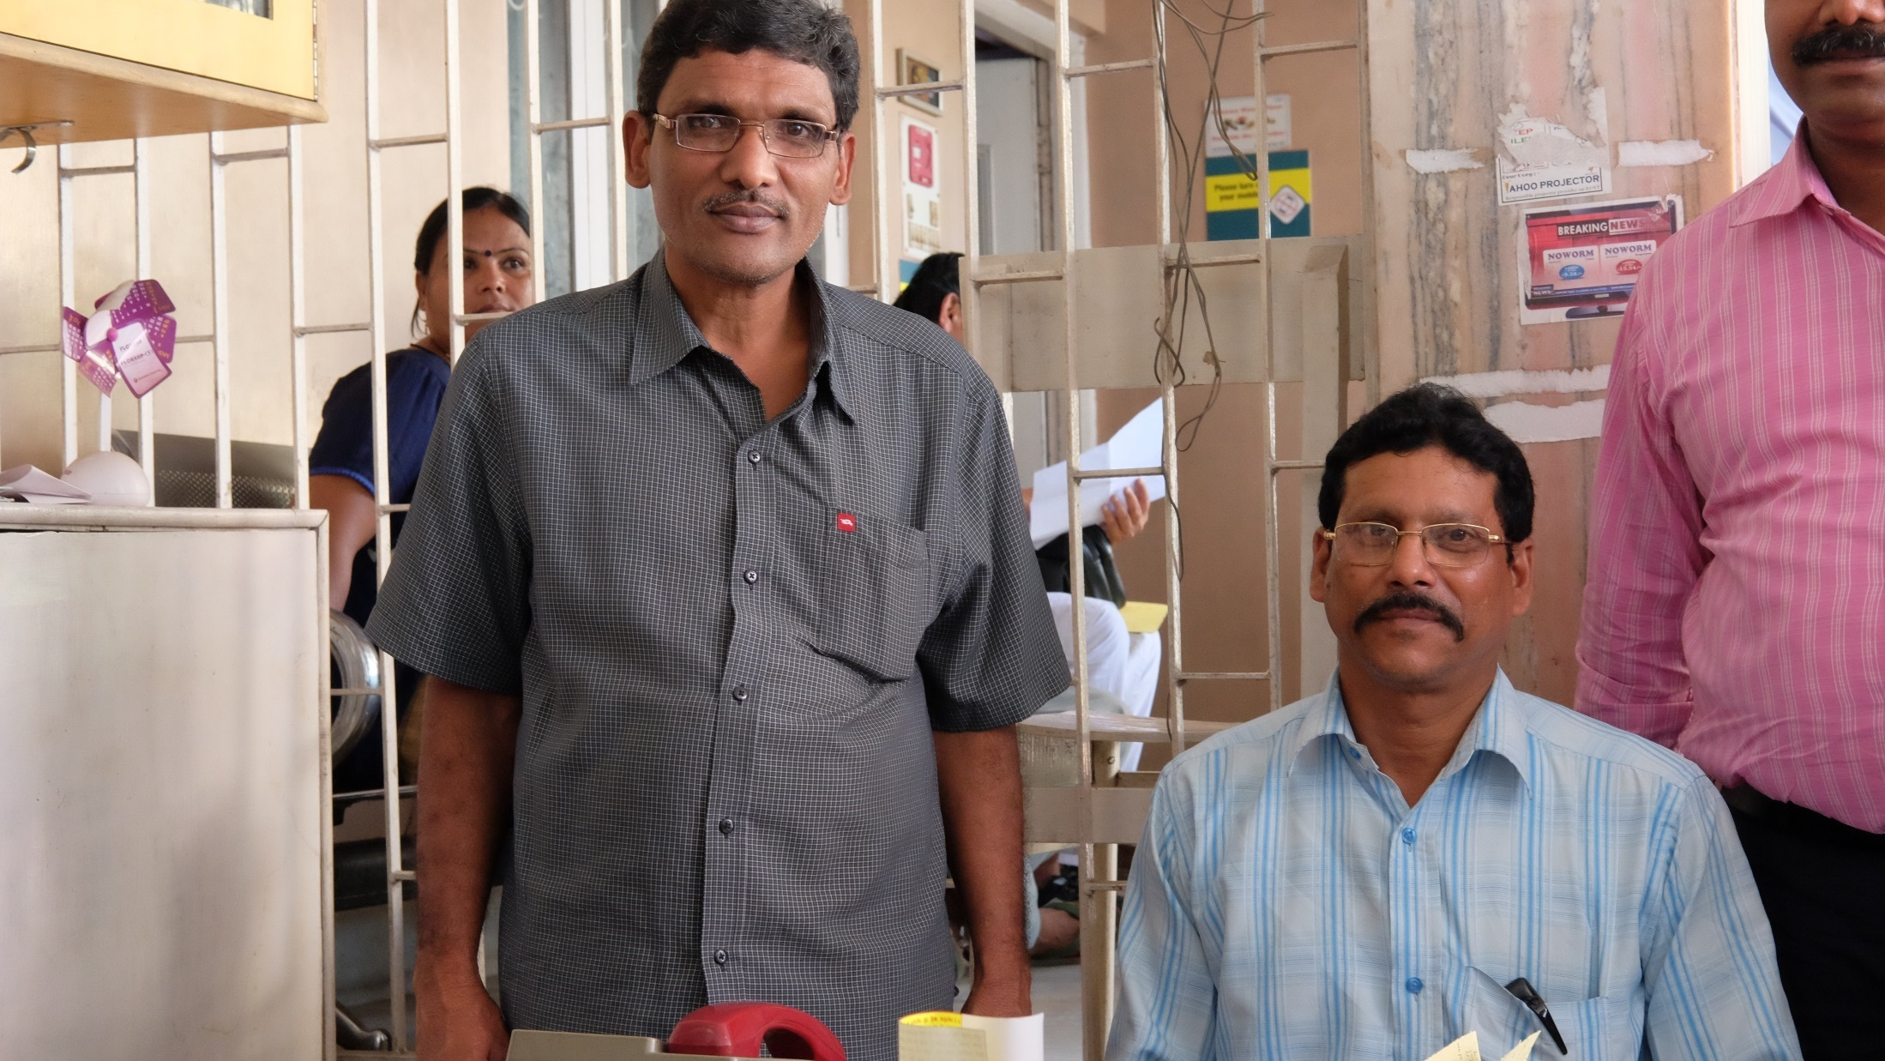
WHAT WORKS FOR PRIVATE
Patna PPIA Field officer and private compounder, 2016

Slide 16
Demonstration site profile
 | Patna | Mehsana | Mumbai
Population | 6,289,193 | 2,167,370 | 12,923,197
% Urban | 33% | 25% | 100%
Epidemic | Unknown | Stable | Scary
Public capacity | Very low | Mod | Mod
Mehsana
Patna
Mumbai
Notes:
Population – completely urban Mumbai; 33% urban in Patna; 25% urban in Mehsana
Public health capacity – health facility to population ratio – Patna - 224614 ; Mehsana – 30000:1; Mumbai – 50000:1
Patients registered in public sector – Patna – 235:1 (4000-4500 per year); Mehsana – 130:1 (2000-2500 per year); Mumbai – 140:1 (30,000 per year)
Private providers – providers to population ratio – Patna – 53:1 (equal AYUSH); Mehsana – 22:1 (1/3rd AYUSH); Mumbai - 18:1 (1.5 times more AYUSH)

Slide 17
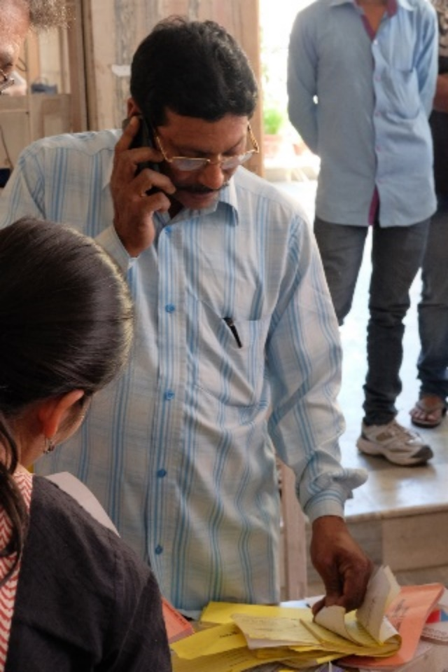

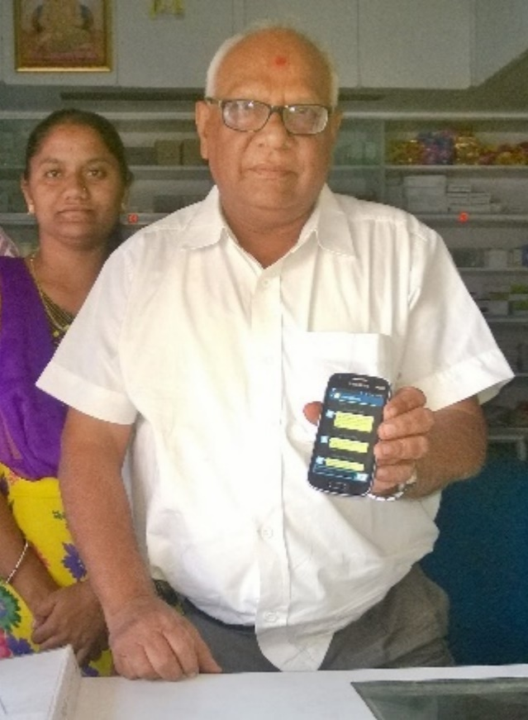
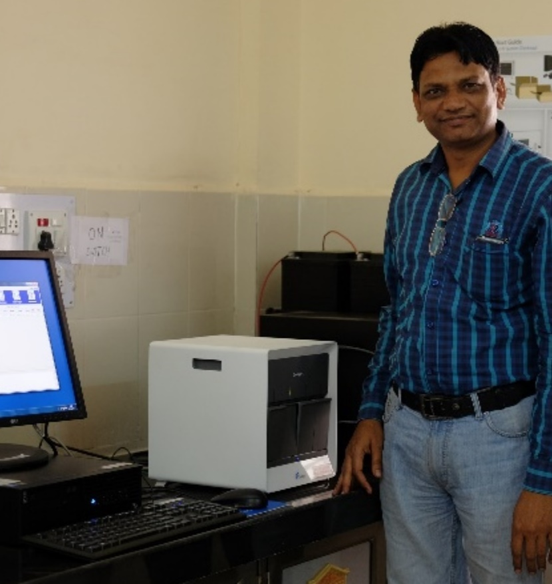
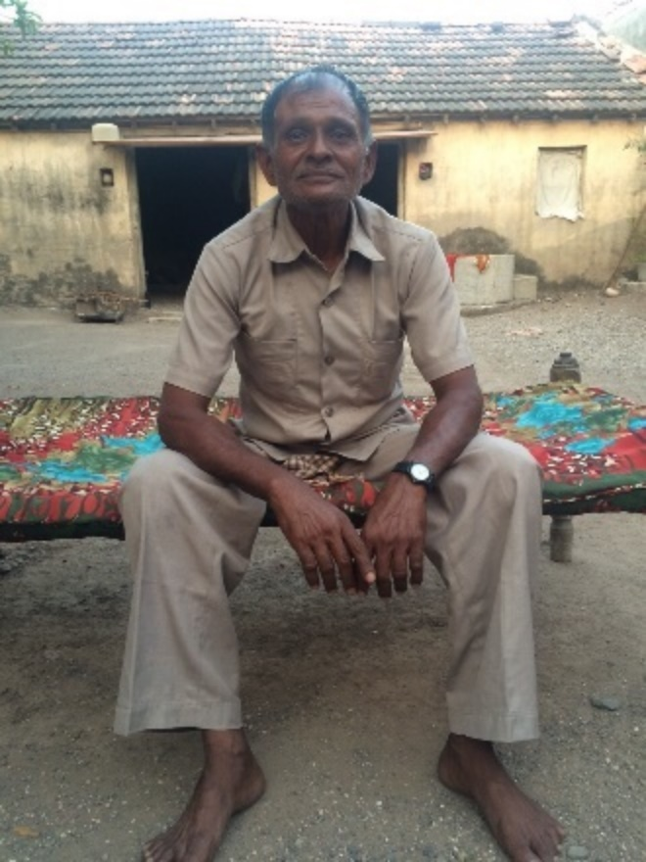
How private engagement works
Attract TB notifications with services
Monitor & improve quality
Sustain treatment
Private/missing
Private notification yields incentives & free TB drugs/test
Call center issues vouchers & tracks adherence
Public/
45% loss
e-Vouchers for drugs/tests
Private quality of care improvement program
Early TB diagnosis & sustained Rx

Slide 18
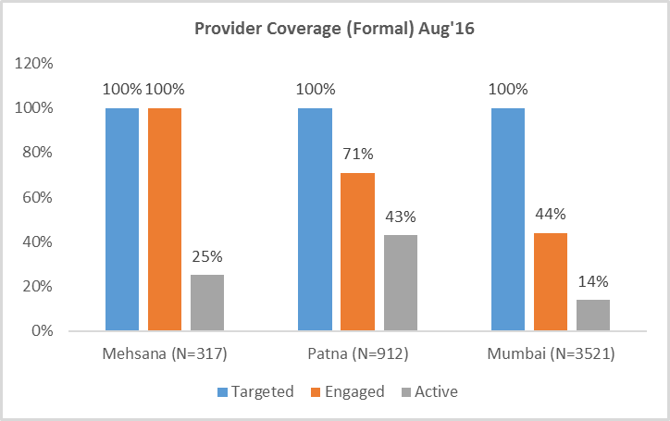
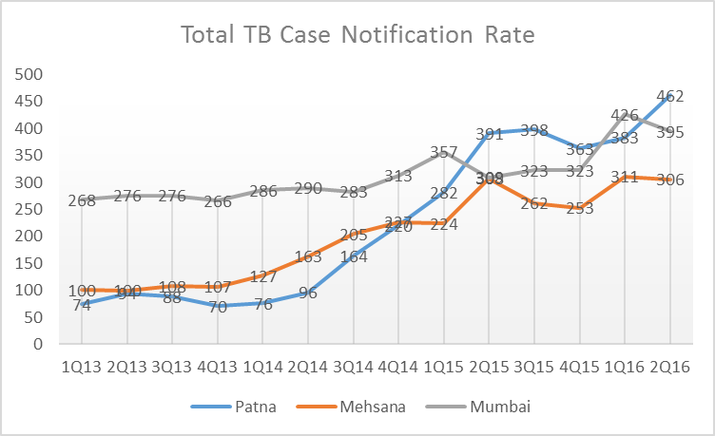
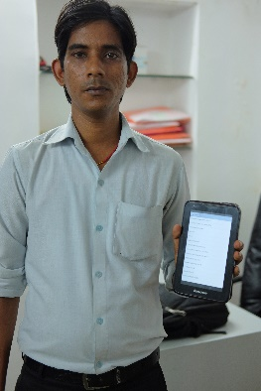
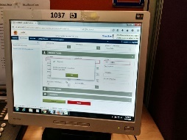
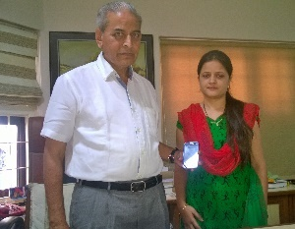
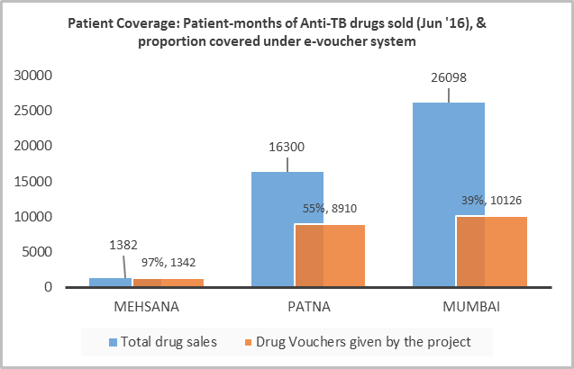
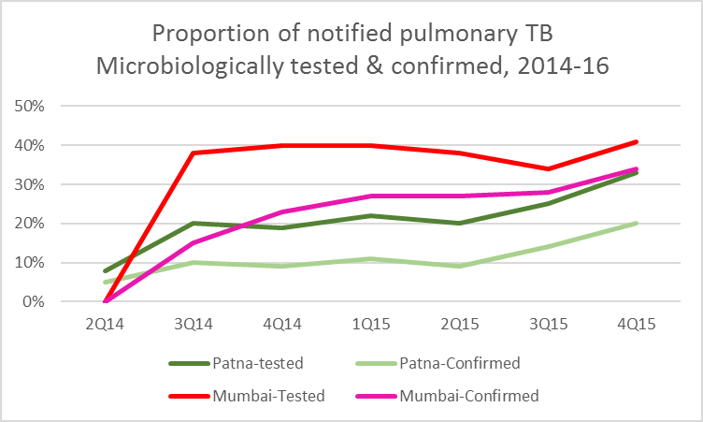
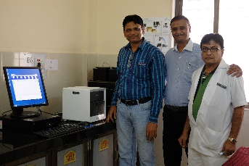
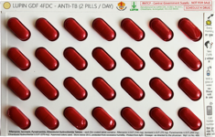
What’s been ACHIEVED IN INITIAL PRIVATE PILOTS…
Track and drive provider & patient coverage relentlessly
Prioritize capture, improve quality with systematic feedback/BCC
Use technology to amplify reach & integrate with RNTCP

Slide 19
increases in Annual tb notification, india private demo sites, 2014 -16
 | Year | Public TB notifications (rate per 100,000 pop) | Private TB notifications (rate per 100,000 pop) | Total TB notifications (rate per 100,000 pop) | Ratio vs 2013
Patna | 2013 | 4,662 (80) | 0 | 4,662 (80) | Ref
 | 2014 | 4.541 (78) | 3,728 (64) | 8,269 (142) | 1.77
 | 2015 | 4,114 (71) | 16,581 (284) | 20,695 (355) | 4.44
 | 2016*(2Q) | 1,946 (67) | 10,355 (355) | 12,301 (422) | 5.28
Mehsana | 2013 | 2,075 (104) | 0 | 2,075 (104) | Ref
 | 2014 | 2,452 (123) | 1,108 (55) | 3,560 (178) | 1.73
 | 2015 | 2,350 (112) | 2,903 (138) | 5,353 (250) | 2.39
 | 2016*(1Q) | 567 (108) | 1,011 (193) | 1,578 (301) | 2.90
Mumbai | 2013 | 31,903 (249) | 2,891 (23) | 34,794 (272) | Ref
 | 2014 | 30,851 (239) | 7,253 (56) | 38,104 (295) | 1.09
 | 2015 | 27,200 (211) | 18,134 (141) | 45,334 (351) | 1.29
 | 2016*(1Q) | 6,426 (199) | 6,285 (195) | 12,177 (394) | 1.45
Source: RNTCP Maharashtra, Gujarat, & Bihar unpublished project data. Please don’t disseminate.
Notes:
1,00,000 or 100,000 population

Slide 20
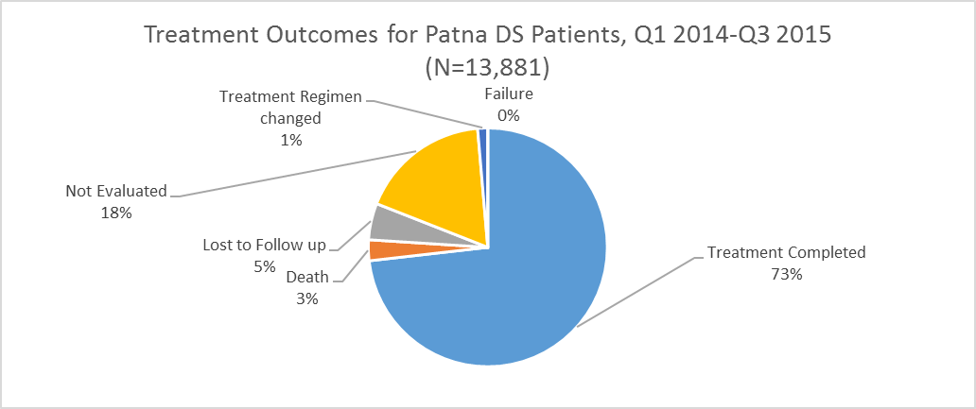
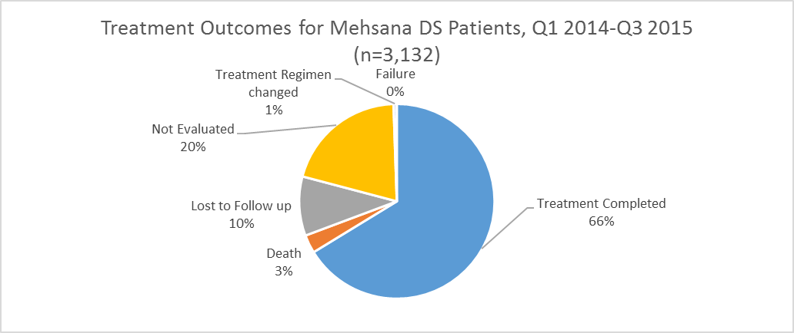
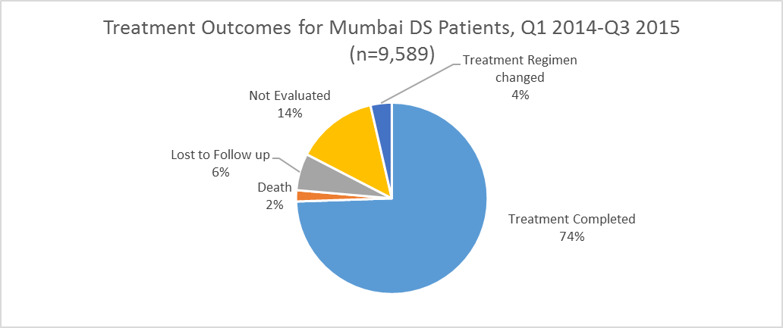
Treatment outcomes
Baseline private treatment data limited
Initial cohorts suggest ~40% treatment completion > 6 months
Initial adherence model limited to free drugs, refill monitoring, & self reporting via weekly check-ins (in-person or call-centre, risk stratified)
Cumulative 26,000 patients, 74% complete >6 months
Source: RNTCP Maharashtra, Gujarat, & Bihar unpublished project data. Please don’t disseminate.

Slide 21
Changing provider behavior: Qutub study behaviours of engaged vs unengaged providers
Engaged chemists are more likely to refer 2-3 week cough and are not prescribing ATT
Engaged providers are:
More likely to use CXR for symptomatics
More likely to use microbiological testing (GX in Mumbai)
Courtesy: Das & Pai et al, Publication pending.

Slide 22
PROJECTED IMPACT OF PRIVATE ENGAGEMENT
Modeled future urban TB incidence, 2016-30, with partial coverage of private engagement. Inputs populated by results from RNTCP urban TB demonstration projects.
Arinaminpathy et al, 2016, work in progress. Publication pending.

Slide 23
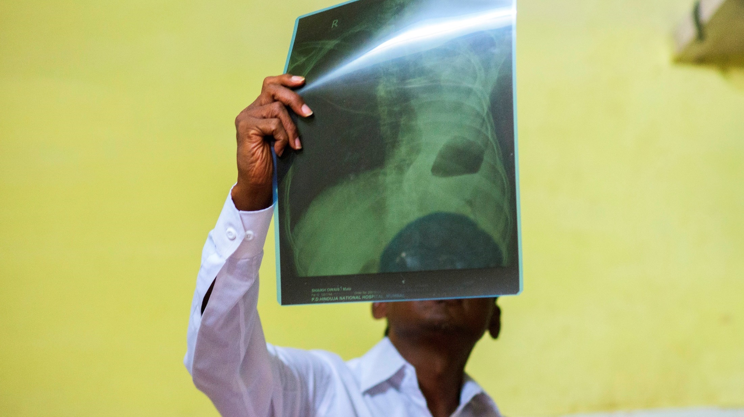
ROLE OF ICT
IN SCALE-UP

Slide 24
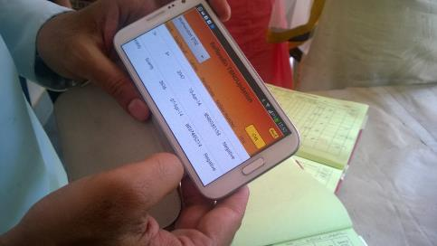
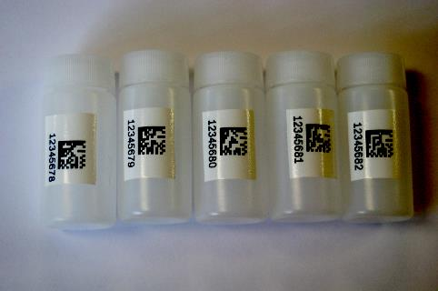
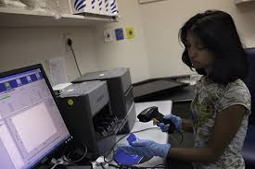

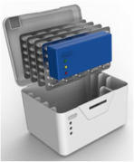
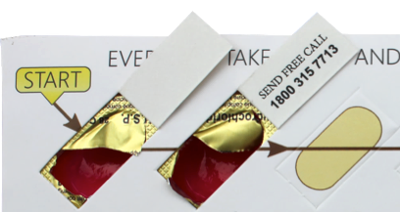
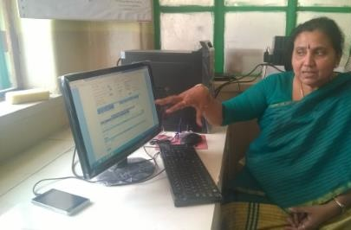
CHALLENGES & ENVISIONED ICT SOLUTIONS
Ignored private cases Missing diagnosed TB cases Missing DR TB suspects- 60 % of the estimated suspects still do not reach labs Attrition of cases at all stages from suspect to treatment completion
Capture of private notifications Notification at diagnosis linked to treatment start Track registered suspects Treatment adherence monitoring Workflow support Alerts to staff and patient when patients lost Accountability for treatment initiation of diagnosed results PAYMENT for confirmed services/commodities

Slide 25
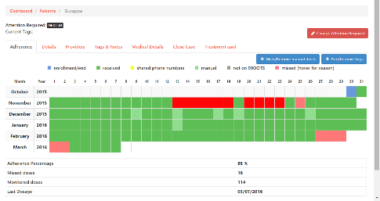
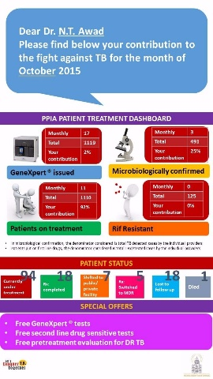
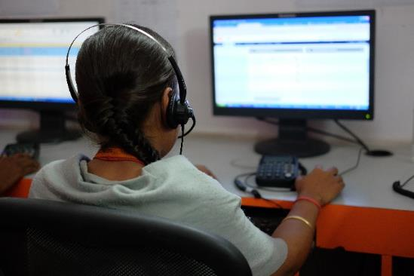
Ict-driven scale-up of private engagement
ICT central to scale-up!!!
Forces service outreach for PP’s into public staff workflow
Force-multiplier – 10 call center seats cover all PP’s in State of Gujarat
Critical integrations
Diagnostics
Adherence tech
Referrals, transfers
Payments (providers & patients)

Slide 26

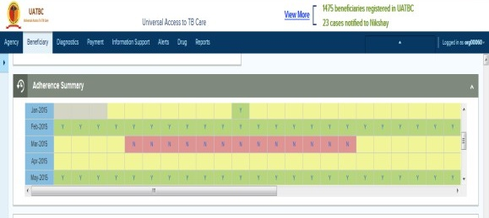




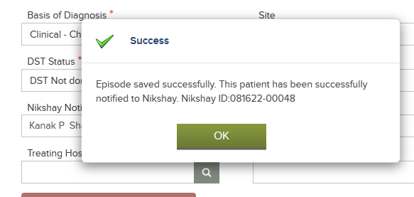
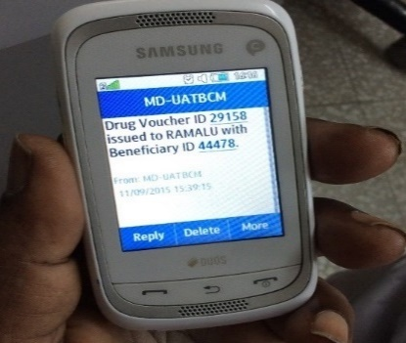
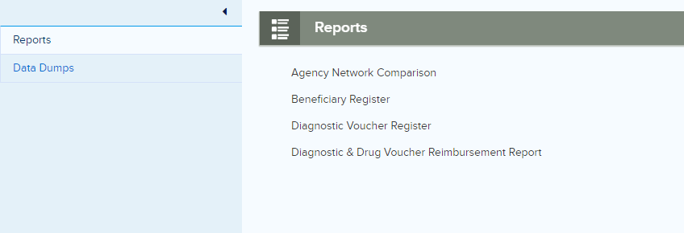
Technology Innovations deployed in pilots
Multi lingual Contact Center
E Vouchers-→ e payments
Monitoring Adherence
Step 1 Step 2 Step 3
Generate redeem voucher online payments
Evoucher free drugs/diagnostics
Dose reminders to patients
Alert to patients on missed doses
Alert to provider, FO on missed doses
Reminder to patient for drug refills
SMS Alerts
Informatics
Integration with Nikshay*
*Nikshay- National TB Surveillance System

Slide 27

Adherence tools
Envisioned to generate routine data on consumption
99DOTS and MERM attempted
Uptake poor in privately-treated TB patients

Slide 28
Tools – in context
counsel
refill
Access medicine
Completes
Stratify/adjust approach
Consider a monthly cycle of care
We might have data on
Who is being treated, by whom and how
Refill / issuance of drugs
Accessing medicine
Data sources
Pharmacist
HCW
Patient (via tool)
Humans required at all steps to intervene on results
What opportunities exist to assist/prioritize/augment their work?

Slide 29

Change management
Tens of thousands of public health workers
30,000 PHCs with TB drugs
12,000 microscopy center lab technicians
20,000 TB supervisors (STS, STLS, TBHV)
700 District TB program teams to use data to supervise, plan, & manage services in public & private

Slide 30
Intervention levels
These aren’t choices as much as they are layers. Which ones should we use, for which setting?
Demand generation
Adherence: Reminders, Refill monitoring & Dose implementation
Diagnostic services & linkage to care
Payments to providers (labs, chemists, quacks, doctors)
Payments to patients

Slide 31


DBT – hope, unrestrained
Patients are largely poor, unquestionably.
Can we nudge adherence with social support via DBT?
Should it be linked to Rx confirmation? It’s feasible, but is it desirable?

Slide 32









GoI ICT ecosystem in TB Care (near future)
Aadhaar
Validate patient’s identity
Drug issuance details
CRM of Nikshay Sampark
Payment Status
Patient interaction details
Adherence Technologies
Payment Instruction
Automated Tests
Patient details
Test Result
CBNAAT
MERM
Adherence data
TrueNat
Patient details
Patient / provider GPS location
Patient’s Nikshay ID
Generate map
Private sector Patient Notification API
Nikshay MIS
Thanks Mitu R Chaudhry & EY

Slide 33

Opportunities during field visit
Understand
Patient priorities
Provider priorities
See
Problems that can be solved with ICT
ICT solutions
Dependencies on system change/support
Assess
Is this a sandbox that makes sense to dive into?
Zakir & family. Courtesy Lilly MDR TB partnership

